Slide 1
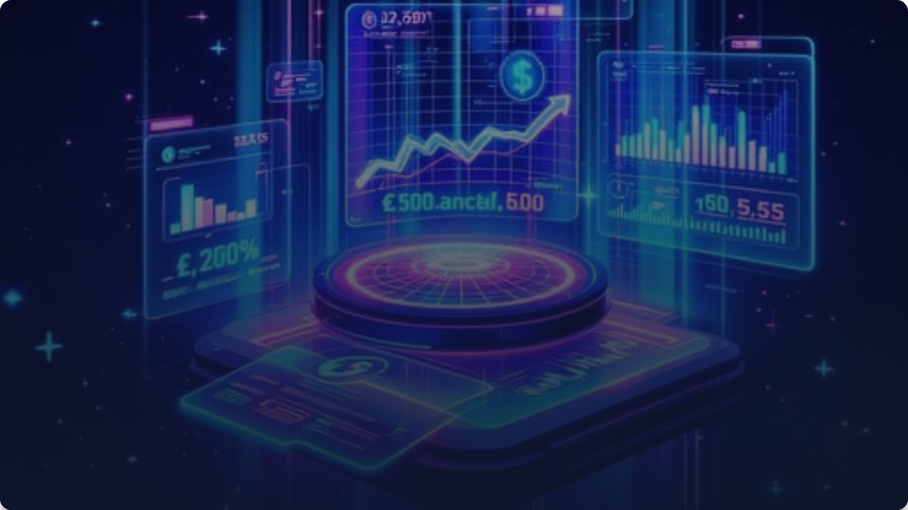





PitchSwipe
Reimagined Investing
Video-First Discovery. AI-Powered. Saudi-Focused.

Slide 2


Today, investors are drowning in information but starving for relevance.
Traditional platforms give you data, but they don't help you feel which startup is the right fit.

Slide 3
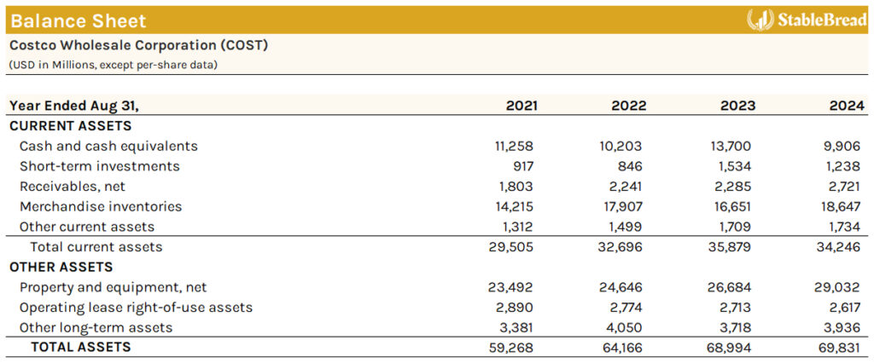
The Generational Shift
Stuck in 2010 UX
Traditional investment platforms were built for analysts, not humans. They assume people want to read long PDFs and dig through static spreadsheets.
How We Consume Today
Young investors explore through video, visuals, and personalization. This is how they discover products, creators, and careers.

Slide 4
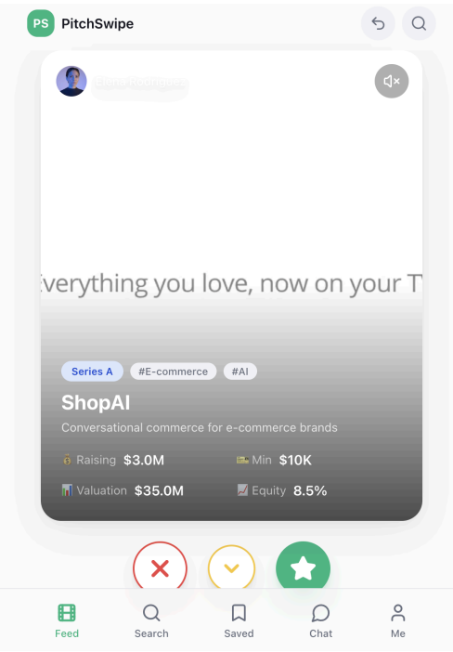
Redesigned for Humans
Video-First Investing
We asked: What if discovering a startup felt as intuitive as scrolling TikTok?
Founders pitch through short vertical videos—a medium that communicates passion and authenticity in a way no PDF ever could.
Simple. Visual. Deep.

Slide 5






Intuitive Discovery
Swipe Left
Swipe Down
Swipe Right
To pass on opportunities that don't match your intrest.
Discover a different video
To instantly unlock deeper details of the company you like and quickly invest.

Slide 6
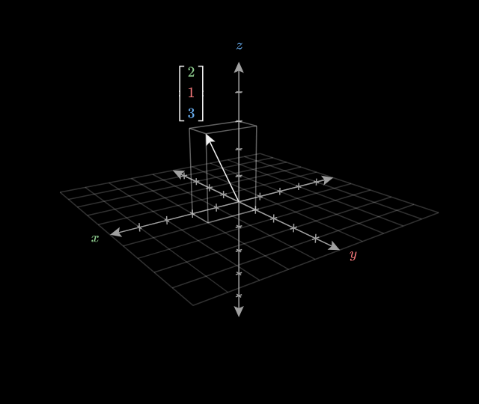
The Vector Engine
Behavioral-Finance Personalization
Every interaction trains our investment brain. When you swipe, watch, or skip, we update your preference vector in real time.
Learns from watch time and engagement
Prioritizes domains you care about
People don't know what they want; their behavior reveals it.

Slide 7





Target Audience: Universal Access
Retail Investors
High Net Worth
Institutions
Accessible entry point for individuals and micro-investors.
Advanced tools for accredited investors and family offices.
All startups and small businesses can benefit and enlist in the app.

Slide 8
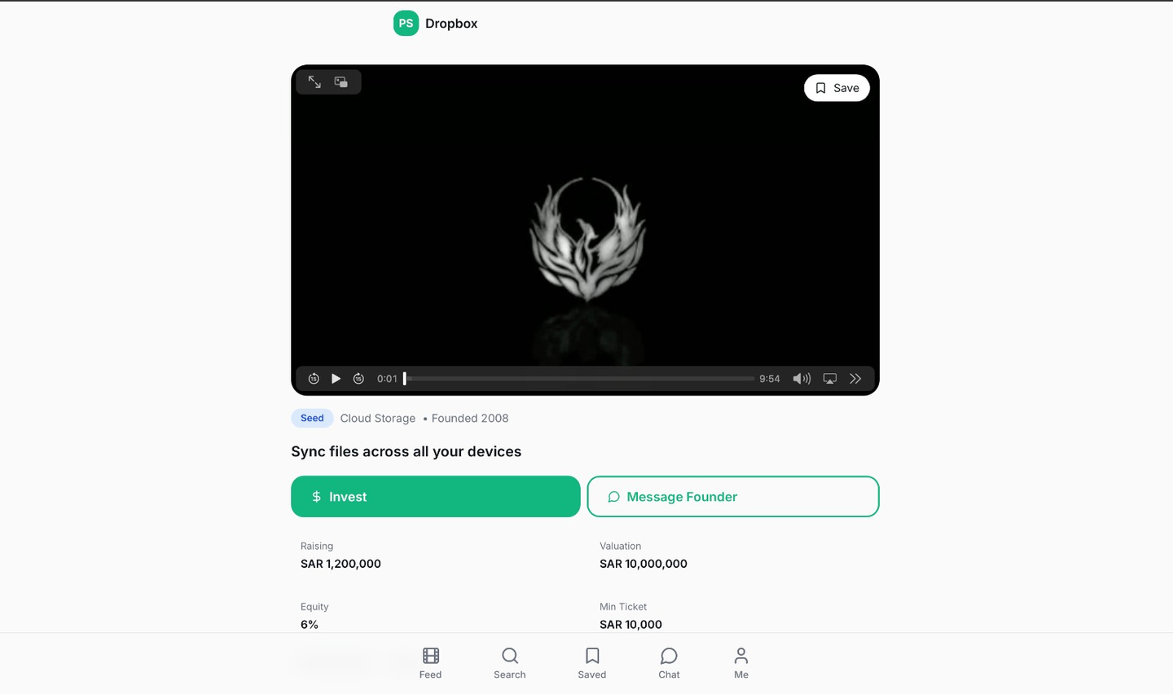

The Company’s Profile Unlock
A Trust Mechanism
On every swipe right, the company’s profile instantly opens. This solves three major problems at once:
Privacy: Founders can contact investors who swiped right.
Engagement: Investors are get to see data as soon as they display interest.
Conversion: Friction disappears and investments are streamlines.

Slide 9

Why Saudi Arabia?
Built for Vision 2030
PitchSwipe isn't just made for the Saudi market—it's made because of it.
Explosive startup growth & fintech momentum.
Energized youth population consuming video content.
Government push for digital transformation.
Young investors entering markets faster than ever.

Slide 10




Value for Everyone
For Founders
For Investors
Direct exposure to investors from all backgrounds. Pitch authentically and get notified when serious investors unlock your data.
Radically simplified discovery. Avoid fatigue, get personalized dealflow, and explore with familiar gestures.

Slide 11

Business Model
Founder Fees
Investor Commissions
Network Effect
Onboarding fee + Monthly subscription for visibility and analytics.
Success fees when allocations happen through regulated partners.
More swipes = Smarter AI = More valuable marketplace.

Slide 12






Roadmap to Scale
Phase 1
Phase 2
Phase 3
MVP Launch & AI Training
Fintech Sandbox Entry
Regional Expansion
"Investment execution happens through regulated partners, allowing us to scale safely."

Slide 13




Not Just a Feature.
A New Category of Financial Interaction.
gihub:
https://github.com/RazakAajil/pitchswipe-dev-guide.git

